Slide 1
SEARCHing AND SORTING TECHNIQUES
Agenda
Linear Search using Arrays
Bubble Sort using Arrays
Binary search using Arrays
Presented
By
Nanam Vaishnavi

Slide 2
Linear Search
Linear search is a technique which allows user to search a particular value from a list of values is available in an array.
Linear search or sequential search.
Advantages
Small to medium arrays can be searched quickly.
Not affected by insertions and deletions.
Disadvantages
Time consuming for the enormous arrays.
Slow search for large array lists.

Slide 3
using System;
using System.Collections.Generic;
using System.Linq;
namespace Linear_Search
{
internal class Search1
{
static void Main(string[] args)
{
Search1 search = new Search1();
int[] search_list = new int[] { 3, 5, 12, 5, 28, 16, 20, 35, 9 };
int p, res;
Console.WriteLine("Enter a value to search: ");
p = Convert.ToInt32(Console.ReadLine());
res = search.LinearSearch(search_list, p);
if (res>0)
Console.WriteLine("The target value " + p + "is found at position " + res);
else
Console.WriteLine("Target Not Found");
Console.ReadLine();
}

Slide 4

int LinearSearch(int[] arr, int target)
{
for(int i=0;i<arr.Length;i++)
{
if (target == arr[i])
return (i + 1);
}
return -1;
Console.ReadLine();
}
}
}

Slide 5
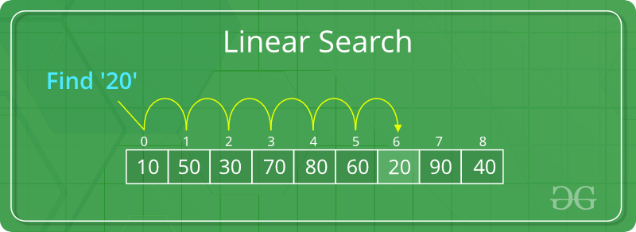

Slide 6
Bubble Sort
Bubble sort is a simple sorting algorithm that works repeatedly by swapping the adjacent values which are there in the jumbled order.
Advantages
It is popular and easy to implement.
Elements are swapped in place without using additional temporary storage .
Disadvantages
The bubble sort is the fact that it does not deal well with a list containing a huge number of items.
It is highly inefficient for large data sets.

Slide 7
EXAMPLE :
First Pass: ( 5 1 4 2 8 ) –> ( 1 5 4 2 8 ), Here, algorithm compares the first two elements, and swaps since 5 > 1. ( 1 5 4 2 8 ) –> ( 1 4 5 2 8 ), Swap since 5 > 4 ( 1 4 5 2 8 ) –> ( 1 4 2 5 8 ), Swap since 5 > 2 ( 1 4 2 5 8 ) –> ( 1 4 2 5 8 ), Now, since these elements are already in order (8 > 5), algorithm does not swap them. Second Pass: ( 1 4 2 5 8 ) –> ( 1 4 2 5 8 ) ( 1 4 2 5 8 ) –> ( 1 2 4 5 8 ), Swap since 4 > 2 ( 1 2 4 5 8 ) –> ( 1 2 4 5 8 ) ( 1 2 4 5 8 ) –> ( 1 2 4 5 8 )
Now, the array is already sorted, but our algorithm does not know if it is completed. The algorithm needs one whole pass without any swap to know it is sorted. Third Pass: ( 1 2 4 5 8 ) –> ( 1 2 4 5 8 ) ( 1 2 4 5 8 ) –> ( 1 2 4 5 8 ) ( 1 2 4 5 8 ) –> ( 1 2 4 5 8 ) ( 1 2 4 5 8 ) –> ( 1 2 4 5 8 )

Slide 8
using System;
using System.Collections.Generic;
using System.Linq;
using System.Text;
using System.Threading.Tasks;
namespace BubbleSort
{
public class BubbleSort1
{
public static void Main(string[] args)
{
int[] arr = new int[10] { 23, 98, 45, 12, 9, 16, 65, 74, 34, 29 };//Array created with 10 unsorted numbers
bubblesort(arr, 10);
int i;
for (i = 0; i < 10; i++)
Console.Write(arr[i]+", ");//Printing the array after sorting in descending order
Console.ReadLine();
}

Slide 9
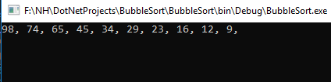
//bubble sort
Static void bubblesort(int[] data, int n)
{
int a;
int b;
for (a = 0; a < n; a++)
for (b = n - 1; b > a; b--)
if (data[b] > data[b - 1])//Condition to arrange array in descending order
{
int temp = data[b];
data[b] = data[b - 1];
data[b - 1] = temp; }
}
}
}

Slide 10
Binary Search
Search a sorted array by repeatedly dividing the search interval in half. Begin with an interval covering the whole array.
It can be implemented on only sorted list of elements.
Binary search is also known as Half-interval search or Logarthimic search.
Advantages
Binary search is an optimal searching algorithm using which we can search desired element very efficiently.
For large lists of data, it works significantly better than linear search.
Disadvantages
This requires the list to be sorted. Then only this method is applicable.

Slide 11
using System;
using System.Collections.Generic;
using System.Linq;
using System.Text;
using System.Threading.Tasks;
namespace Binary_Search
{
internal class BSearch
{
static void Main(string[] args)
{
BSearch search = new BSearch();
int[] search_list = new int[] { 2, 3, 9, 20, 68, 25, 74, 62, 50, 80 };
int b, res;
Console.WriteLine("Array Elements: ");
foreach (int i in search_list)
Console.Write(i + " ");
Console.WriteLine();
Array.Sort(search_list);
Console.WriteLine("Sorted Array: ");

Slide 12
foreach (int i in search_list)
Console.Write(i + " ");
Console.WriteLine();
Console.WriteLine("Enter a value to search: ");
b = Convert.ToInt32(Console.ReadLine());
res = search.search_value(search_list, b);
if (res > 0)
Console.WriteLine("Target Value " + b + " is found at position " + (res + 1));
else
Console.WriteLine("Target bot found!");
Console.ReadLine();
}

Slide 13
int search_value(int[] arr, int target)
{
int low, high, mid;
low = 0;
high = arr.Length - 1;
mid = (low + high) / 2;
while (low <= high)
{
if (arr[mid] == target)
return mid + 1;
else
if (target < arr[mid])
high = mid - 1;
else
low = mid + 1;
mid = (low + high) / 2;
}
return -1;
Console.ReadLine();
}
}
}

Slide 14
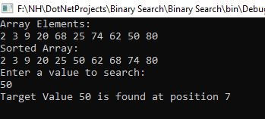

Slide 15
